Slide 1
LAB 12

Slide 2
Strings are a sequence of characters which are widely used in java programming.
The most direct way to create/initialize a string would be as follows: String xyz=“Hello!”;
The String class also has a few predefined methods which we can use to manipulate and do things with our String data, which we will generally use with a String variable.

Slide 3
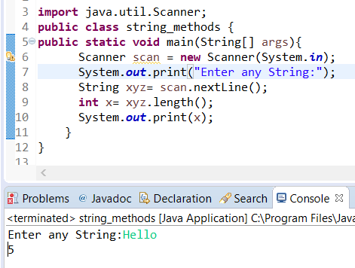
String Length: length() It return’s the length of the string.

Slide 4
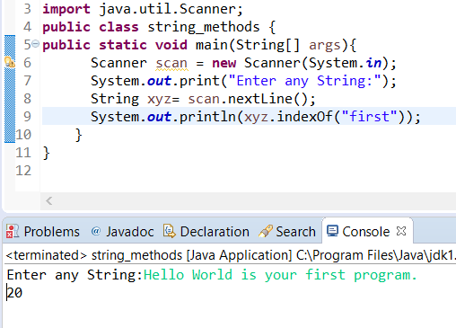
Finding a character in a String. The indexOf() method returns the index (the position) of the first occurrence of a specified text in a string (including whitespace)

Slide 5
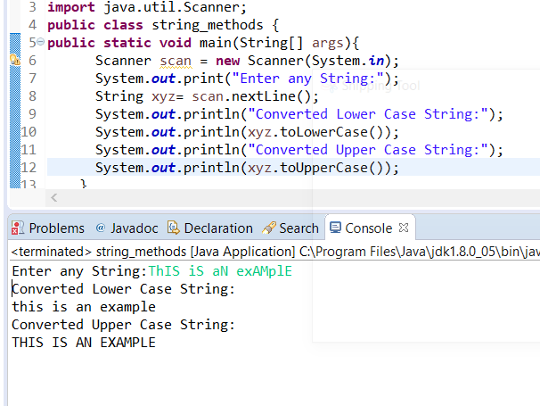
toLowerCase() : converts to lowercase (returns a String) toUpperCase() : converts to uppercase (returns a String)

Slide 6
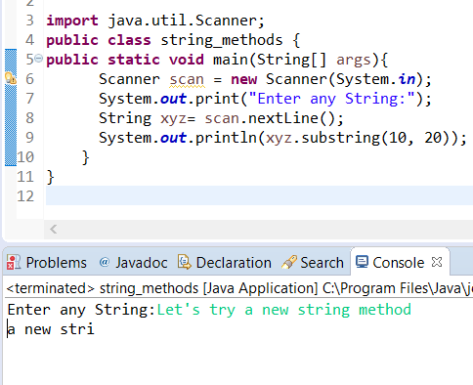
substring(start, end) : extracts the substring from start (an integer) to end (another integer) (returns a String)

Slide 7
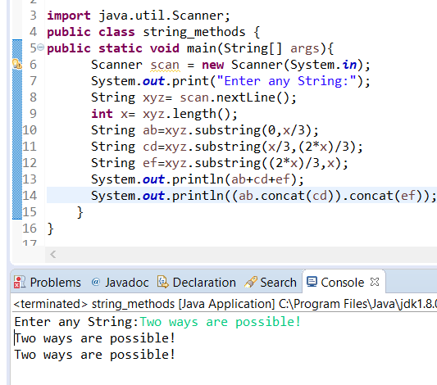
String Concatenation The + operator can be used between strings to combine them. This is called concatenation: We can also use the concat() method to concatenate two strings:

Slide 8
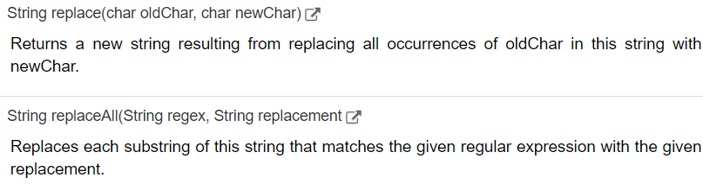
There are many other methods as well such as:
contentEquals(): Which returns true if two strings are same.
String trim():
Returns a copy of the string, with leading and trailing whitespace omitted
And many more but these are the important one’s.

Slide 9
Thank You!

